Slide 1
Thank you for your patience. The presentation will begin momentarily.
Please remember to place your phones on mute.

Slide 2

Identity & Access Management (IAM)
Access Certification Ops Walkthrough
May 29, 2019

Slide 3

Session Overview
2019 Access Certification Ops: Audit Walkthrough
Objective: To educate our audit partners on the 2019 IAM Access Certification process changes.
Agenda:
Campaign Scope
Training
Walkthrough the Process Document
Certification Results & Artifact Packages
Certification Changes & Enhancements
Automated Test
Q & A

Slide 4
2019 - SailPoint Campaign Scope
2019 Access Certification Ops: Audit Walkthrough
Certifications will be launched on a quarterly basis and consist of applications with compliance sensitivity: SOX, SSAE16, and NYDFS
Approximately 706 applications in scope for 2019 as of 5/22/19. Note: Scope is subject to change.
2019 - Target SailPoint Campaign Calendar
Annual Access SailPoint Certification calendar activities and time frames performed within each quarter. Note: Dates are subject to change.

Slide 5
2019 Access Certification Ops: Audit Walkthrough
Training
Training Session:
Preview sessions for Application Owners’ Certification Administrators
Conducted multiple training sessions
Required Attendance for Application Owners/Certification Administrators
Content Covered:
Certification Highlights & Enhancements
Application Validation Form (AVF) Form
Requirements: Examples – Queries & Raw Extracts
Automated Email Notification Timeline
Pre-Campaign Guidelines for Application Owners
IAM Access Certification Status Dashboard
Q & A
Appendix – Knowledge and Support

Slide 6

2019 Access Certification Ops: Training
Certification Campaign Phases
Pre-Certification Campaign
Certification Campaign
Post-Certification Campaign
Phase 1
Data Requirements:
RAW Query Screenshot
RAW application extract
Flat file (If Applicable)
Uncorrelated Account Verifications
Phase 2
Reports:
1:1 Data Validation Report
Comparison Report – Validation & Sign-Off
Certification Phase
28 – Day campaigns to continue
Escalation to Certifier’s manager to continue at Day 22
User Alert – Loss of Access notifications to be sent as campaign nears closure
Phase 3
Reports:
Decision Report
Phase 4
Reports:
Reconciliation Reporting - Validation and Sign-Off

Slide 7
2019 Access Certification Ops: Training
Certification Folder Structure for Audit Packages
Application Validation Form Snapshot
QA Worksheet
Application Owner Extract Upload
Screen Print
Raw Extract
Application Profile
1:1 Data Validation
Entitlement Description file
Certification app Extract
Comparison File
Decision Report
Decision Report
Reconciliation Report
Reconciliation Report
Reconciliation Evidence

Slide 8
2019 Certification Enhancements - RACF
What’s new in 2019?
1:1 Data Validation Automated Process - Design changes were made to the validation process to simplify the certification preparation experience for application and IAM teams working to build access certification campaigns. IAM will initiate with RACF in Q2 and will expand the service to other certification targets throughout 2019.
Why?
All applications undergo a cumbersome manual certification data review process
The new 1:1 automated data validation is meant to simplify building certification campaigns
Expedite process - for RACF, the 1:1 validation was transformed into a single one click process for all in-scope 67 applications
How?
IAM will implement a standard external ETL process that, after configuration for an application, will be able to:
1. Query the data in the application’s staged SailPoint campaign.
1. Query the application’s data by one of three* options.
- For RACF: Query SailPoint for Full Data (based on pre-approved mapping file)
2. Compare the data.
3. Generate a spreadsheet report with the matches and differences for the application owner to validate.
* See appendix

Slide 9
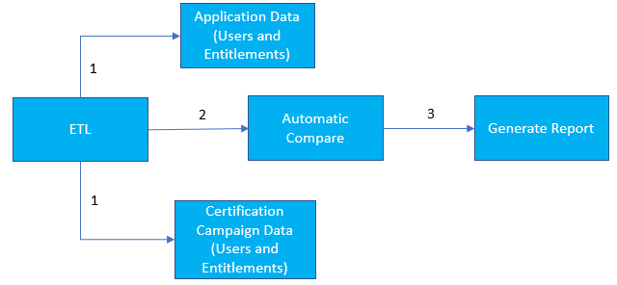
2019 Certification Enhancements - RACF
Benefits
Fewer discrepancies due to timing issue
The process can be rerun anytime to obtain updated data
Once configured, simplified reports for new certification campaign
Automatic production of five-tab Excel file
Application team will no longer provide a RAW extract comparison, or a screen print of the query

Slide 10
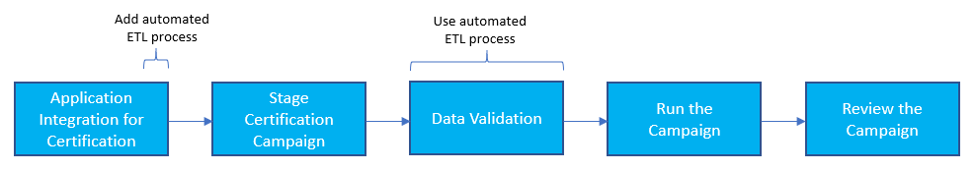
2019 Certification Enhancements - RACF
High-level changes
Current Process
Phase 1:
- App. Team validates/confirms the RACF mapping file
- App. team provides screenshot of raw extract query with date and timestamp
Phase 2:
- App. team performs 1:1 validation by comparing the raw extract and the SailPoint data
- App. team provides justification for the data not included in the campaign and sign-offs on 1:1 validation
Phase 1:
- App. team validates/confirms the RACF mapping file
Phase 2 :
- Ops team executes data load in SailPoint
- Ops team executes the ETL job that performs 1:1 validation between app. raw extract and SailPoint data
- App. team provides justification for the data not included in the campaign and sign-offs on 1:1 validation
Future Process

Slide 11
2019 Certification Enhancements - RACF
Certification Campaign Phases
Pre-Certification Campaign
Certification Campaign
Post-Certification Campaign
Phase 1
Validation:
App team validates RACF mapping file
Phase 2
Automated 1:1 Data Validation:
Timestamped data load in SailPoint
Timestamped Automated 1:1 Data Validation Report via ETL tool (comparison between the raw extract and SailPoint data)
Comparison Report - Validation & Sign-Off
Certification Phase
28 – Day campaigns to continue
Escalation to Certifier’s manager to continue at Day 22
User Alert – Loss of Access notifications to be sent as campaign nears closure
Phase 3
Reports:
Decision Report
Phase 4
Reports:
Reconciliation Reporting - Validation and Sign-Off

Slide 12
2019 Access Certification Ops: Audit Walkthrough
Automated Test
Decision Report Completeness and Accuracy / Automated Revocation Decision
See attached
Prevent Self-Certification
Demo

Slide 13
Q&A

